Slide 1

The Geology of Sculpting Stone
Indiana Limestone
Michael E. Yeaman

Slide 2
Outline
The Stone Defined
  General Description, History of Use and Physical/Chemical Properties
  Specimens (macro and thin section)
  Specific Occurrences
Geology
  Age and Geologic Description
  Formation Environment and Processes
  Global Paleogeographic Setting
  Modern Analogs
Select Creations
  Art
  Architecture

Slide 3

General Description, History of Use and Physical/Chemical Properties
Indiana Limestone is the common name given Salem formation limestone, which is fine grained, buff and gray in color and crops out in southwest Indiana
Quarrying of Indiana Limestone began in 1827 with the opening of the Richard Gilbert Quarry.
  Quarried stone was produced for local use only prior to the building of railways in the 1850's.
  By 1900, Indiana limestone represented 1/3 of the total U.S. dimension limestone industry, and increased to 80% by 1920.
  Currently 9 active quarries that produce 76,000 cubic meters of Indiana Limestone each year
Where quarried, the Salem Formation varies from 8 to 18 meters in thickness, and is unusually massive (i.e., lacks major bedding planes and/or stylolites (pressure dissolution surfaces))
Chemically pure, relatively soft and easily worked when quarried, but once the quarried and dries, becomes case-hardened: harder and more resistant to weathering
No preferential direction of cleavage, therefore can be easily shaped by machine and hand
Chemical Composition of Indiana Limestone
CaCO₃ | 97.3%
MgCO₃ | 0.4%
Al₂O₃ | 0.5%
SiO₂ | 1.7%

Slide 4
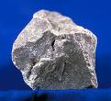
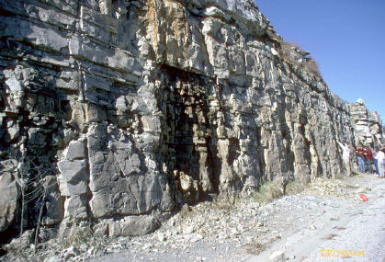
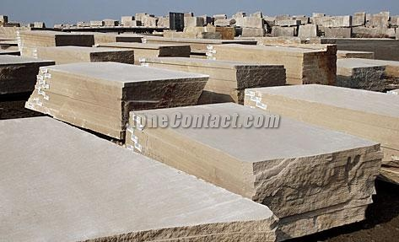
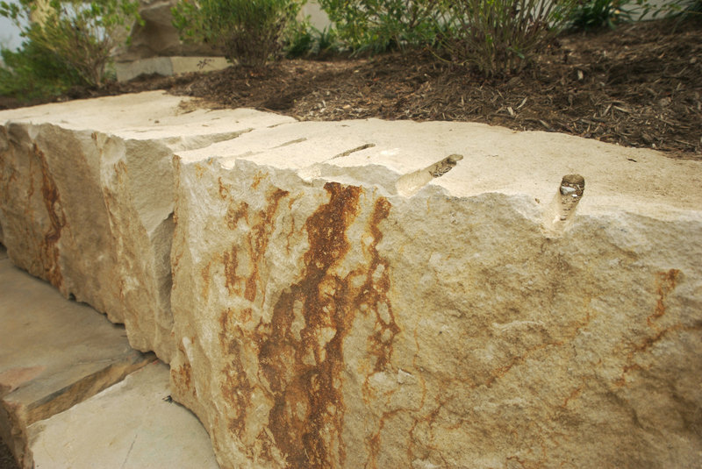
Specimens: Macro
Hand Specimen
Outcrop
Prepped Blocks and Slabs
Rough Blocks

Slide 5
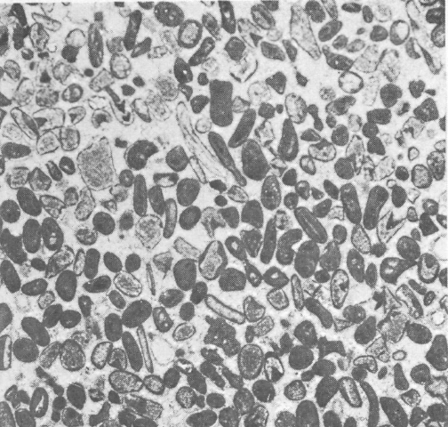
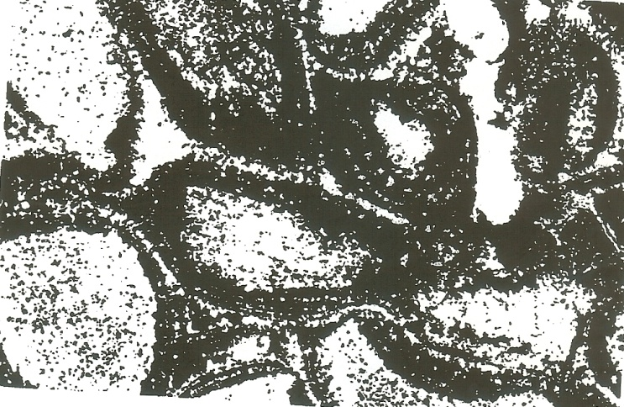
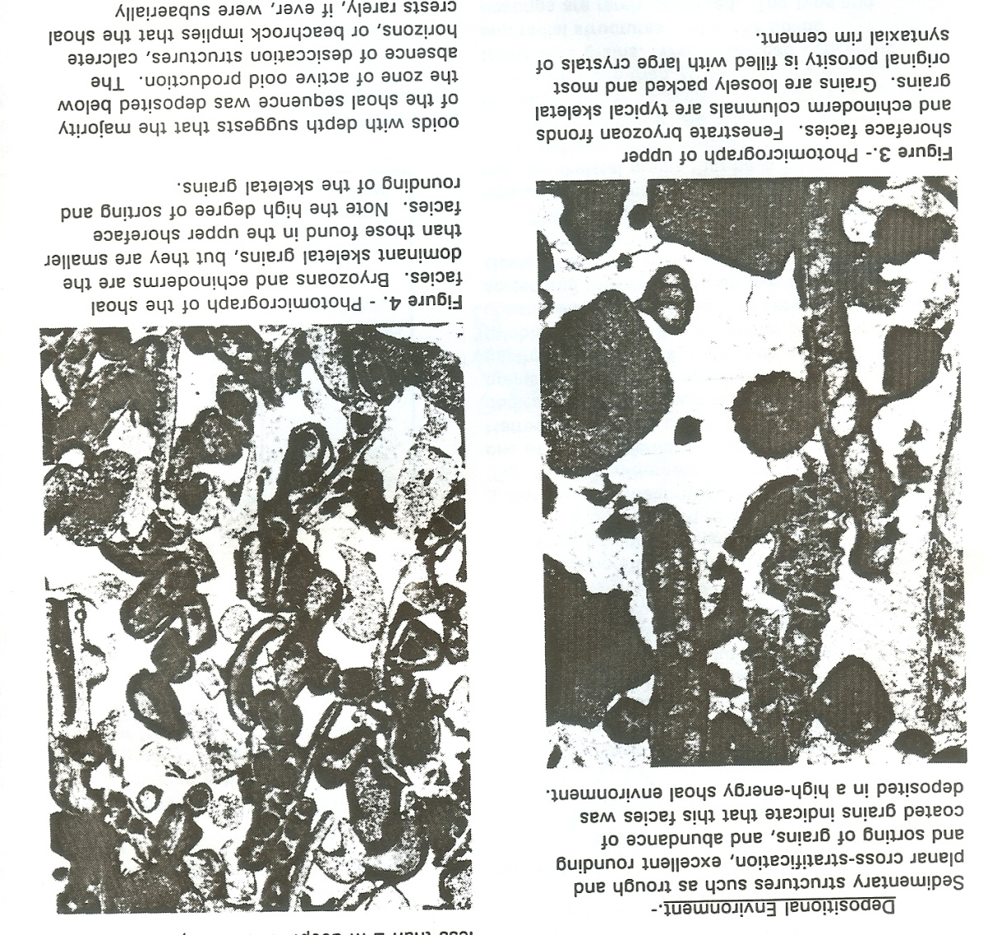
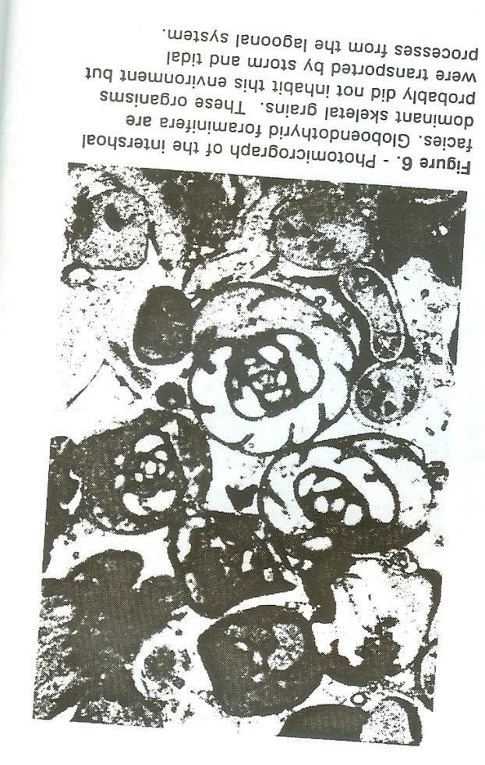
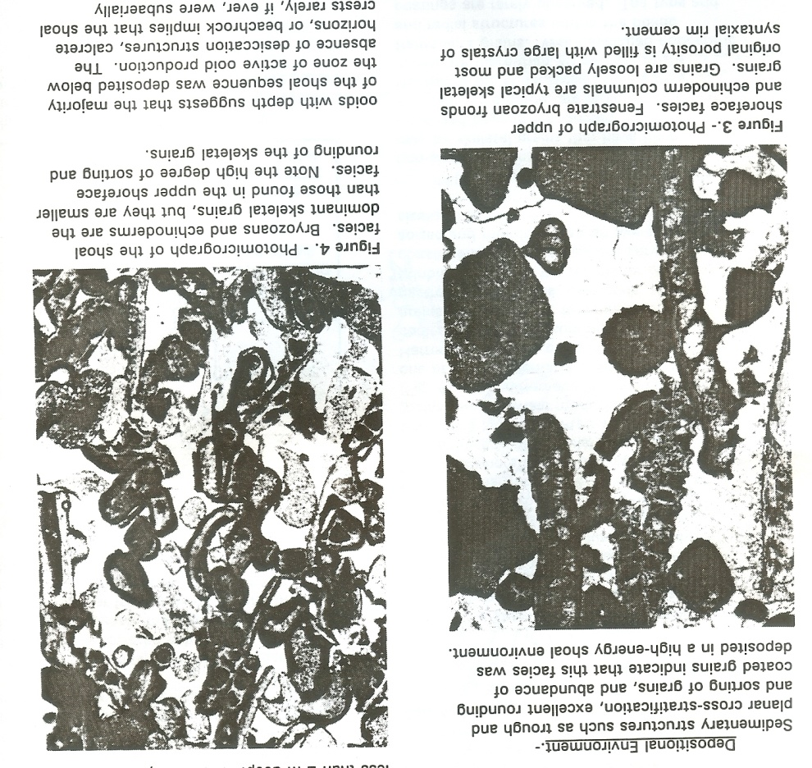
Specimens: Thin Sections
(About 20X Magnification)
Ooids showing the beginning of pressure dissolution and micrite formation
Well-sorted, circular shell/test fragments
High energy shoal facies
Fenestrate bryozoan fronds and echinoderm columnals
Shoal facies
Bryozoan and echinoderm fragments
Intershoal facies
Globoendothyrid Foraminifera
(transported in)

Slide 6
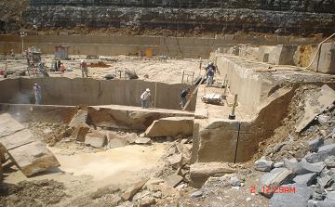

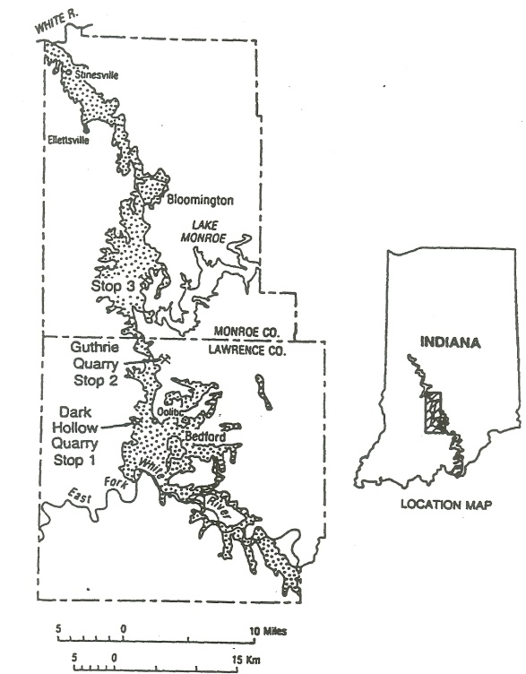
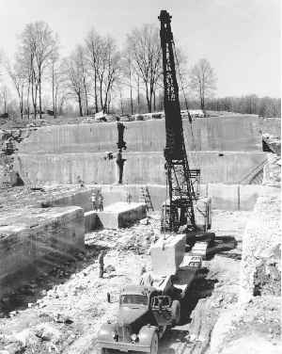
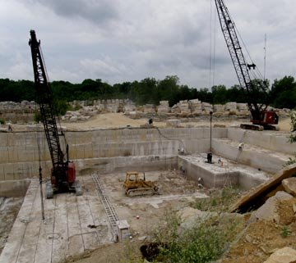
Specific Occurrences
Salem formation (Indiana Limestone) outcrop
Mid 20th Century Quarrying
Active
Modern
Quarries

Slide 7
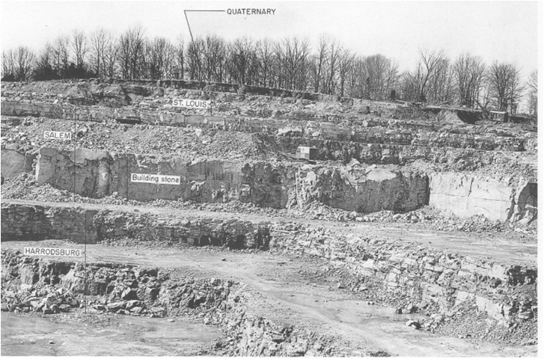
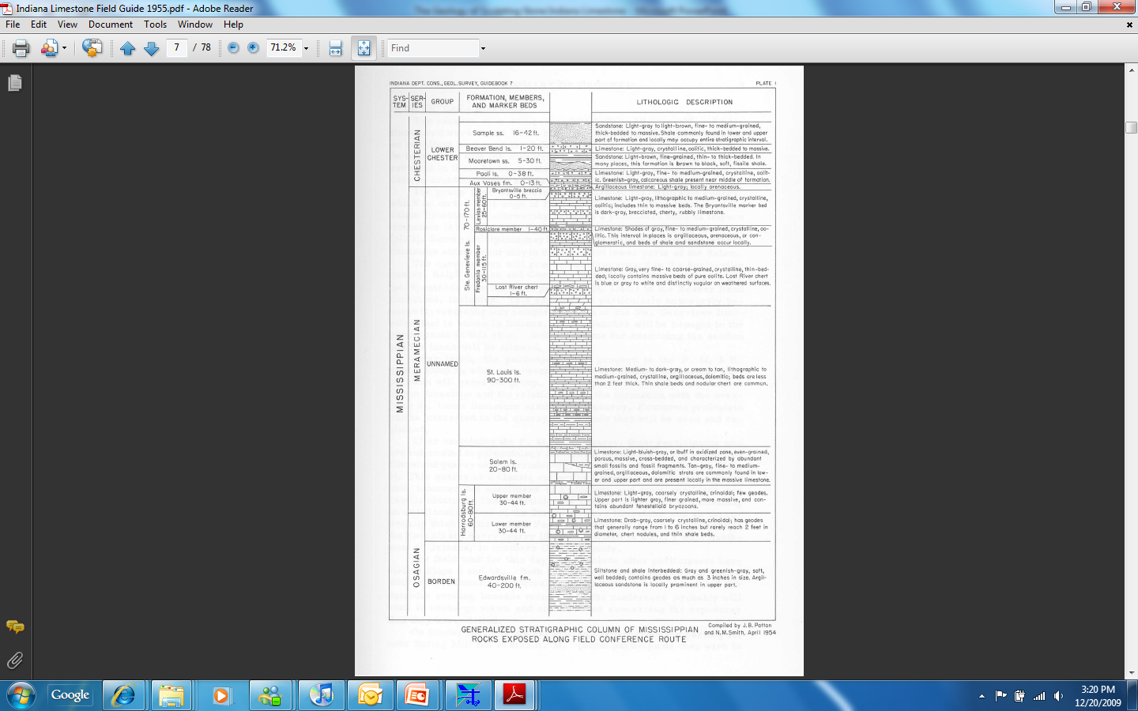
Age and Geologic Description
Formation Lithologic Description
Column
Mississippian/Valmeyeran (≅ 340 MYA )
Salem Lst.
20-80 ft,
Limestone, light bluish-gray or buff in oxidated zone, even grained, porous, massive, cross-bedded and with by abundant small fossils and fossil fragments

Slide 8
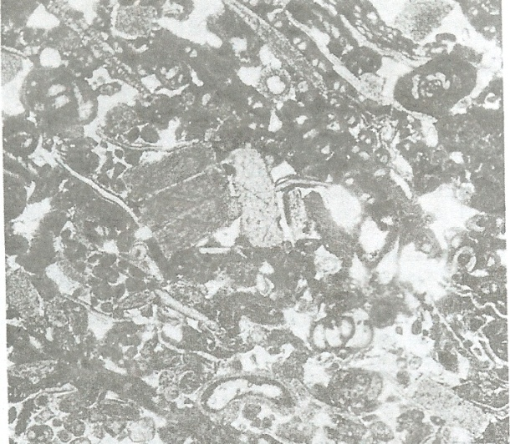
Age and Geologic Description
Crossbedded calcarenite: medium to coarse grained, tan, gray tan, and light gray, porous, and fairly well sorted
Occurs in exceptionally thick beds is the most widely known rock type of the Salem Limestone and is the internationally known budding-stone facies
Individual grains are mostly microfossils (including especially the foraminiferid Globoendothyra baileyi), macrofossil fragments, and whole diminutive forms of macrofossils; coated grains are also common
Other lithologies, besides the shale of the Somerset, include much finer and coarser calcarenites, biocalcirudites: very fine grained argillaceous dolomite commonly containing wavy black carbonaceous laminae
Very fine grained to dense limestone in places including oolites, and dense argillaceous dark-gray to dark-brown limestone (Pinsak, 1957).
Endothyra baileyi Foraminifera fragments in Indiana Limestone

Slide 9
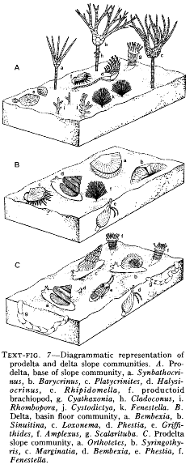
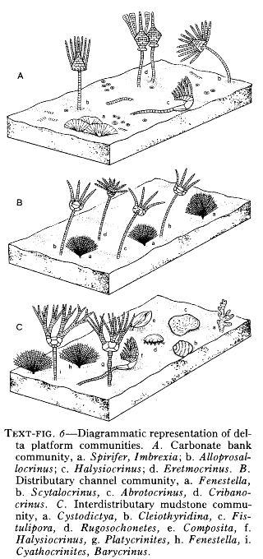
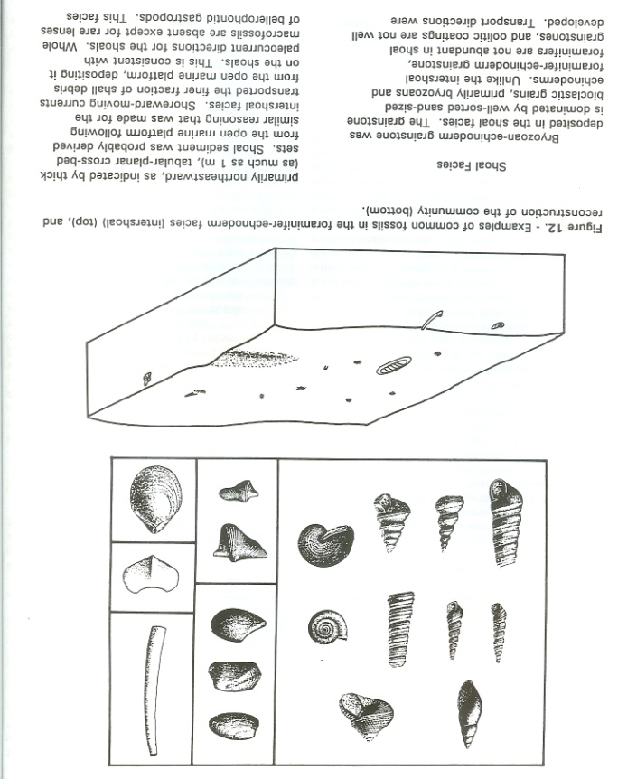
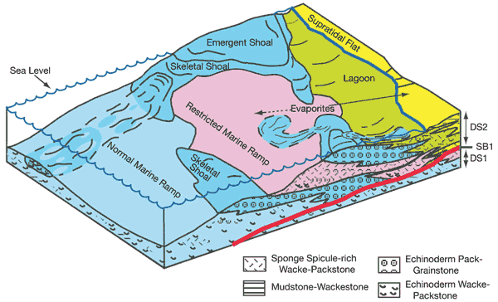
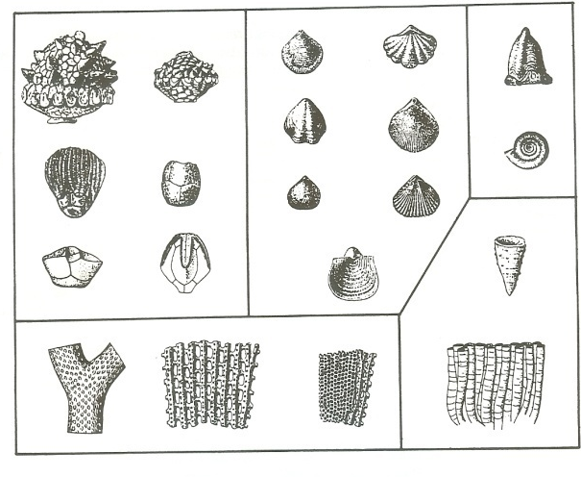
Formation Environment and Processes

Slide 10
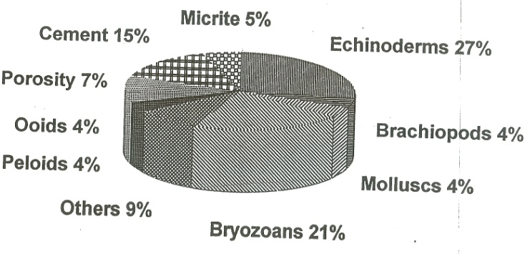
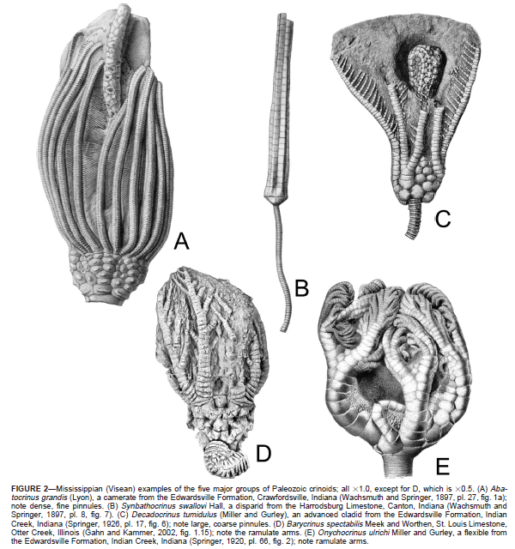

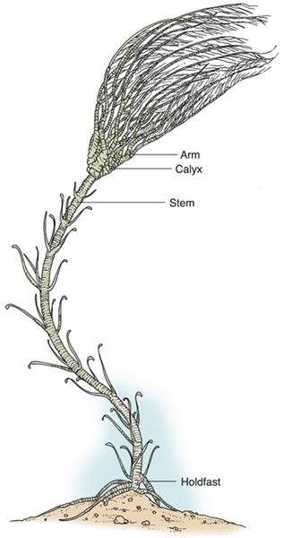
Formation Environment and Processes
Limestone Composition
Major
Paleozoic
Crinoid
Groups
Crinoid
Components
Reconstruction of a Mississippian Marine Environment

Slide 11
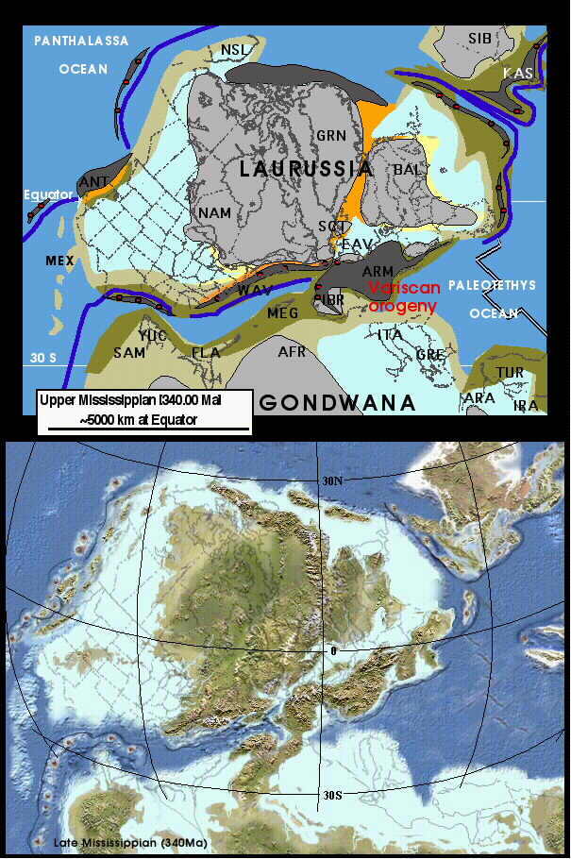
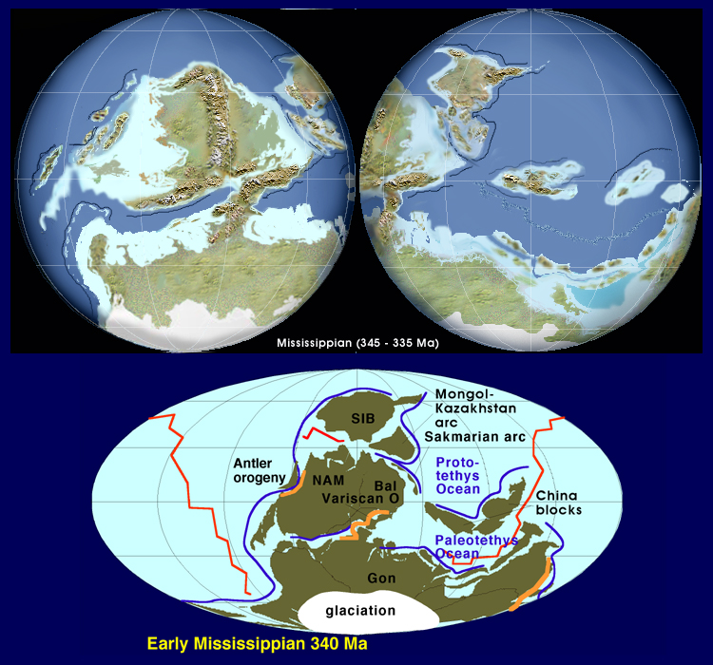
Global Paleographic Setting
Indiana Limestone
Paleographic
Location

Slide 12

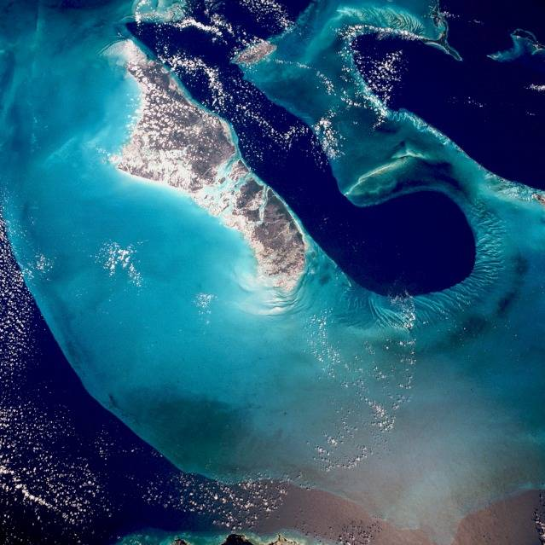
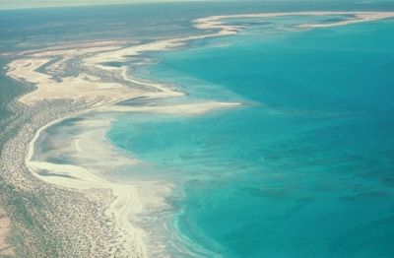
Modern Analogs
Shark Bay, western Australia
Bahamas Platform

Slide 13
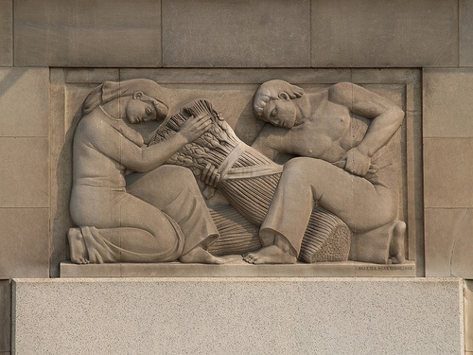
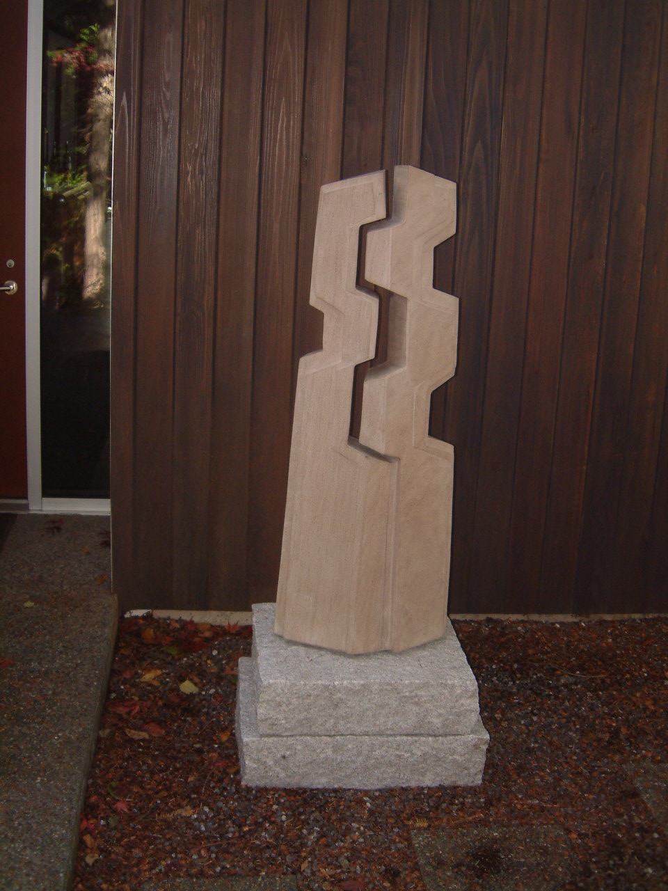
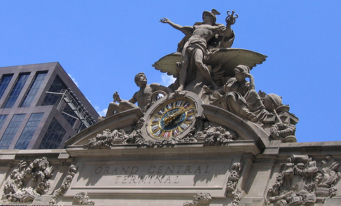

Art
Bas relief Department of Commerce
Washington D.C.
Grand Central Terminal New York
Art Deco bas relief
Rockefeller Center, New York
“Small” Totem

Slide 14
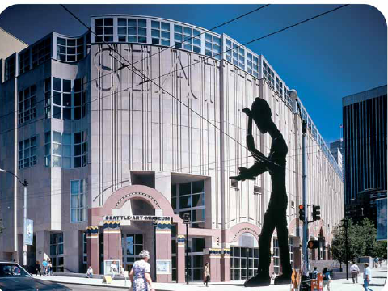
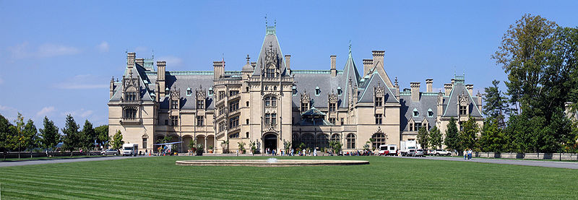
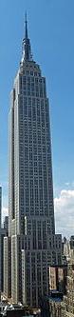
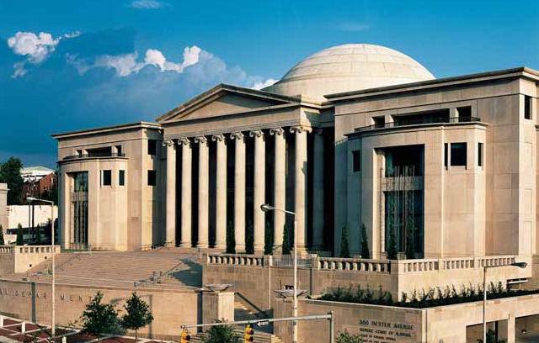
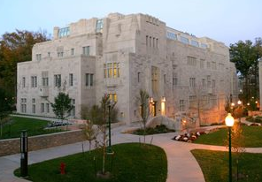
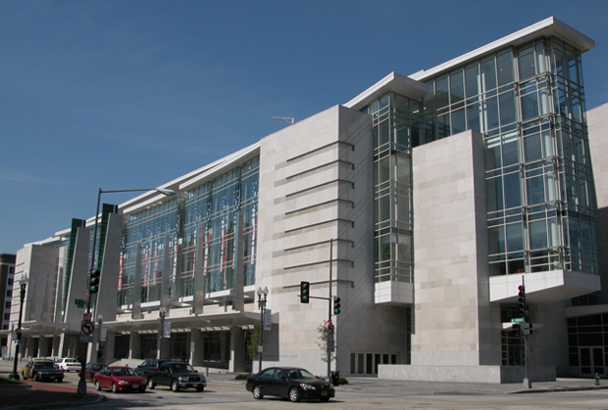
Architecture
Vanderbilt Mansion, North Carolina
Seattle Art Museum
Alabama Judicial Center
Simon Hall Indiana University
Empire State Building
New York
Washington D.C. Convention Center

